Slide 1
Motivating Example

Slide 2
A
B
C
D
E
F
G
Program 1:
color(var0, gray)
/\ front(var0, var1)
/\ color(var1, brown)
Output:
{ var0 = G, var1 = F }
Program 2:
color(var0, gray)
/\ front(var0, var1)
/\ shape(var1, cube)
Output:
{ var0 = G, var1 = C }
{ var0 = G, var1 = B }
Program:
color(var0, blue) /\ shape(var0, cube) /\ size(var0, large)
/\ left(var0, var1) /\ left(var1, var2)
/\ left(var0, var2) /\ color(var2, blue) /\ shape(var2, cube)
/\ size(var2, large) /\ material(var2, rubber)
Output:
{ var0 = A, var1 = B, var2 = C }
Notes:
Show one at a time
Use colors
Conjunction of predicates over the symbolic representation

Slide 3
Neurosymbolic Synthesis Algorithm

Slide 4
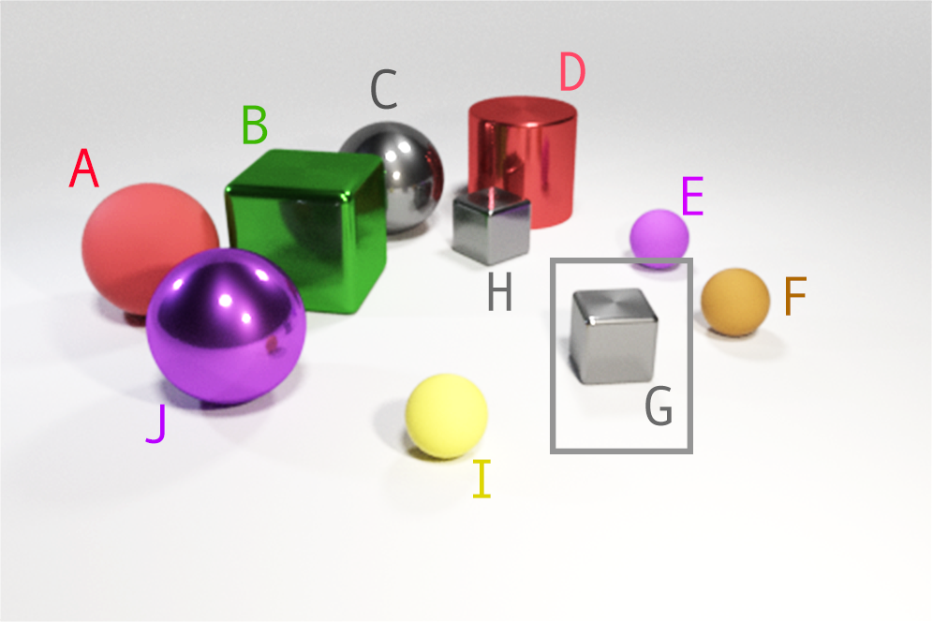
gray(var0)
(Action)
front(var0, var1)
(Action)
GNN
GNN
(State)
(State)
Interpreter
(Environment)
Interpreter
(Environment)
var0
var1
var0
var1
Input (Symbolic)
brown(var1)
(Action)
GNN
(State)
(State)
Interpreter
(Environment)
1
(Reward)
var0
var1
var0
var1
Notes:
Show a picture of the symbolic execution now

Slide 5
Q-Network Architecture

Slide 6
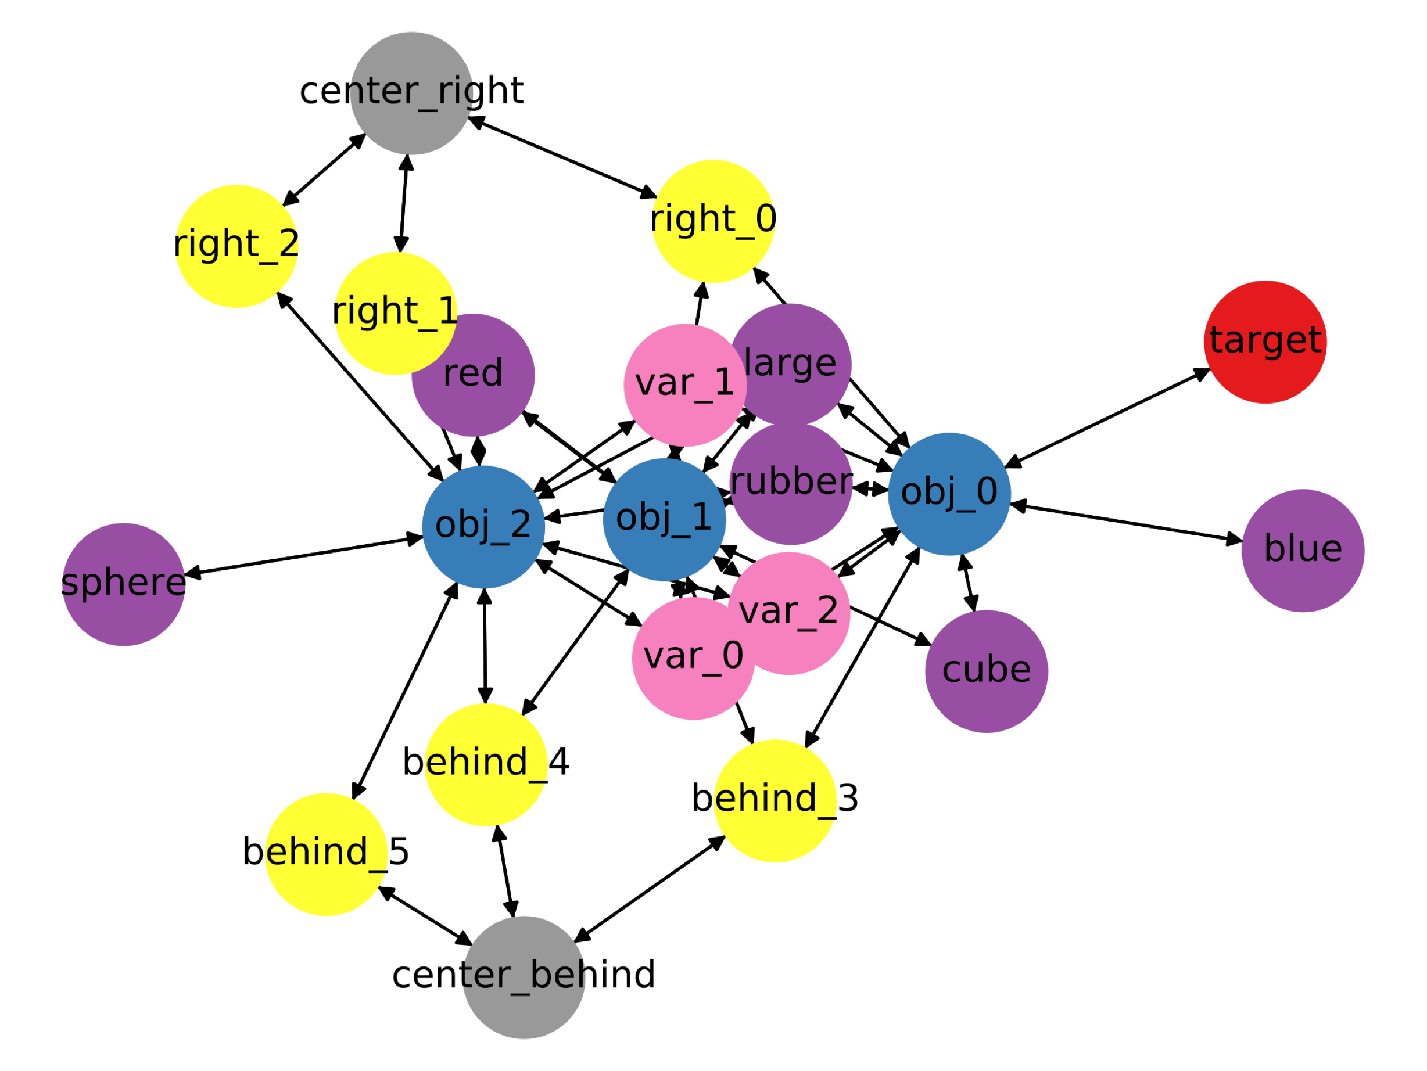

Slide 7
State
GNN Encoder
LSTM Decoder
[0.95, …, 1.20]
(Q-Values)
Notes:
Show a picture of the symbolic execution now

